Slide 1
Introduction to Layer-2 Switching

Slide 2
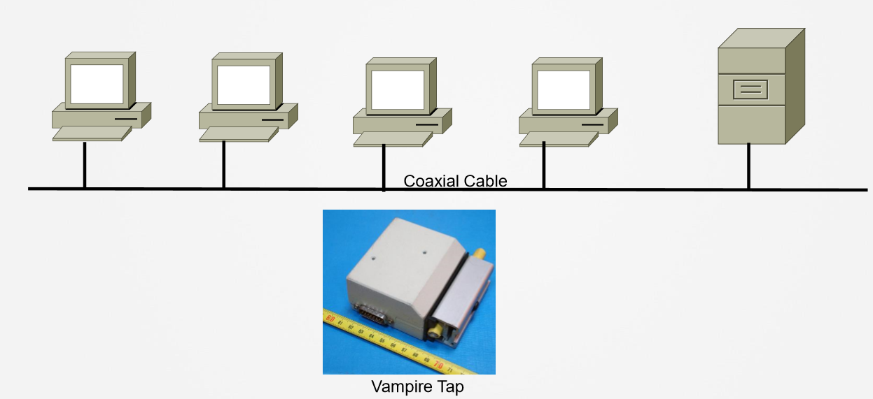
Evolution of Switching (1)

Slide 3
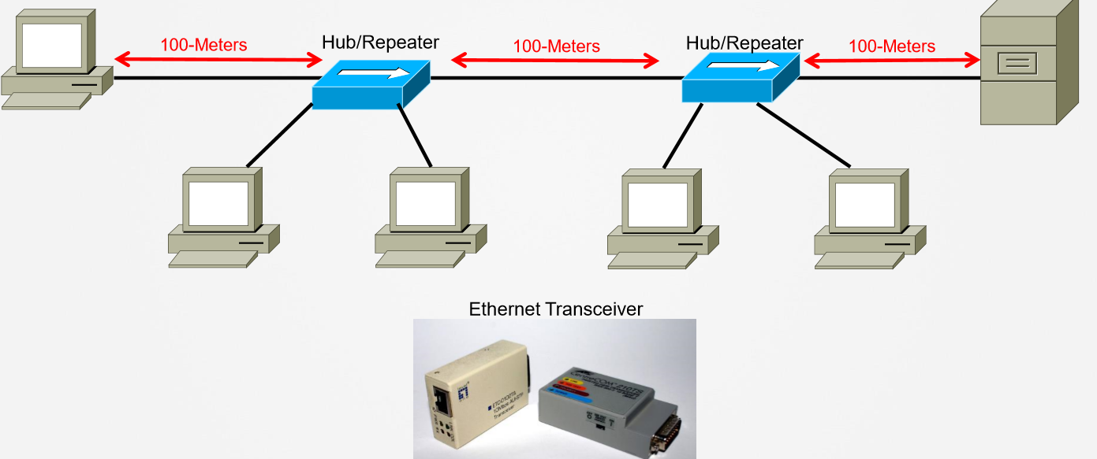
Evolution of Switching (2)

Slide 4
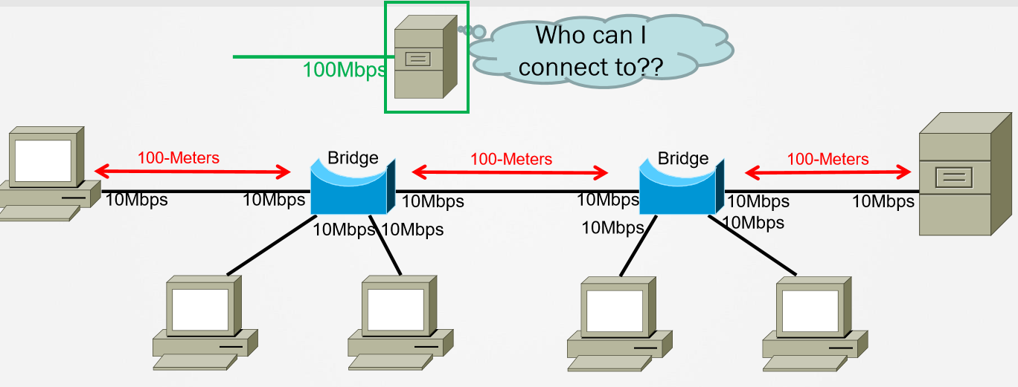
Evolution of Switching (3)

Slide 5
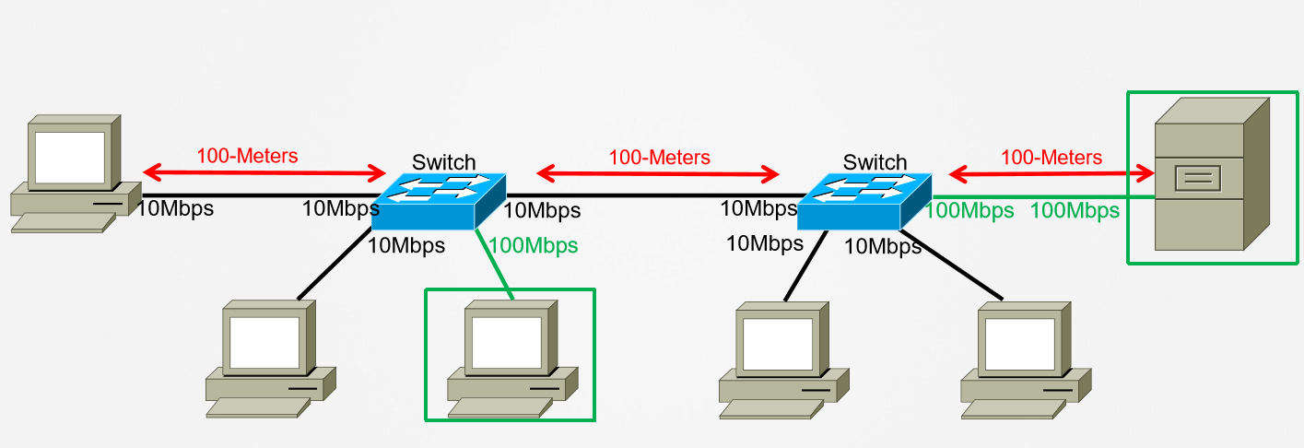
Evolution of Switching (3)

Slide 6
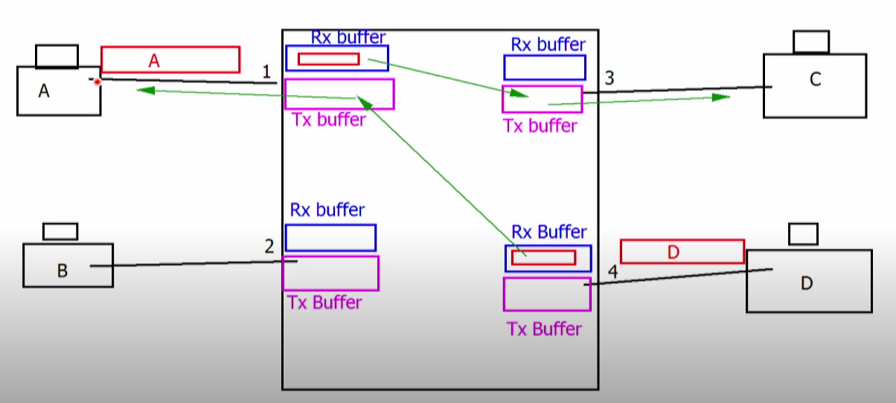
Every Port of Switch one collision domain

Slide 7
Intro to Switching
» Switch is a multiport bridge
• More ports than a bridge
• Mixture of port speeds & types
» Forwards frames based on the MAC address table
» Separates collision domain
» Operates in data link layer

Slide 8
MAC-Address Table
» Switch MAC Learning
• Based on Source MAC Address
• Addresses age out after inactivity-timer
» Switching forwarding
• Based on Destination MAC
• Broadcast/Multicast/Unknown flooding
• All ports initially in one, large, broadcast domain

